Slide 1
CUDA Advanced Libraries
Thrust Data Reordering and Sorting

Slide 2
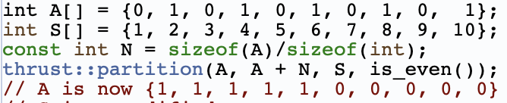
Reorder Syntax
2 types of reordering partitioning and stream compaction
partition(first, last, stencil, predicate)
first and last describe the interval for reordering
stencil is an iterator describing the order to perform operations, immutable
predicate is the operation used to partition on, which can be binary or categorical
[1]

Slide 3
Thrust Sort
sort has 3 ”modes”:
default – 2 args, first and last, sorts the values based on data type default greater operator
thrust::sort(A, A + N);
sort keys and move values accordingly – 3 args: keys first, keys last, and value first
thrust::sort_by_key(keys, keys + N, values);
custom greater operator and sorts values – 3 args: first, last, and greater operator
thrust::stable_sort(A, A + N, thrust::greater<int>());
[1]

Slide 4
References
[1] 2021. NVIDIA. CUDA Developer Toolkit Documentation – Thrust Library. Found at https://docs.nvidia.com/cuda/thrust/index.html.

